Slide 1
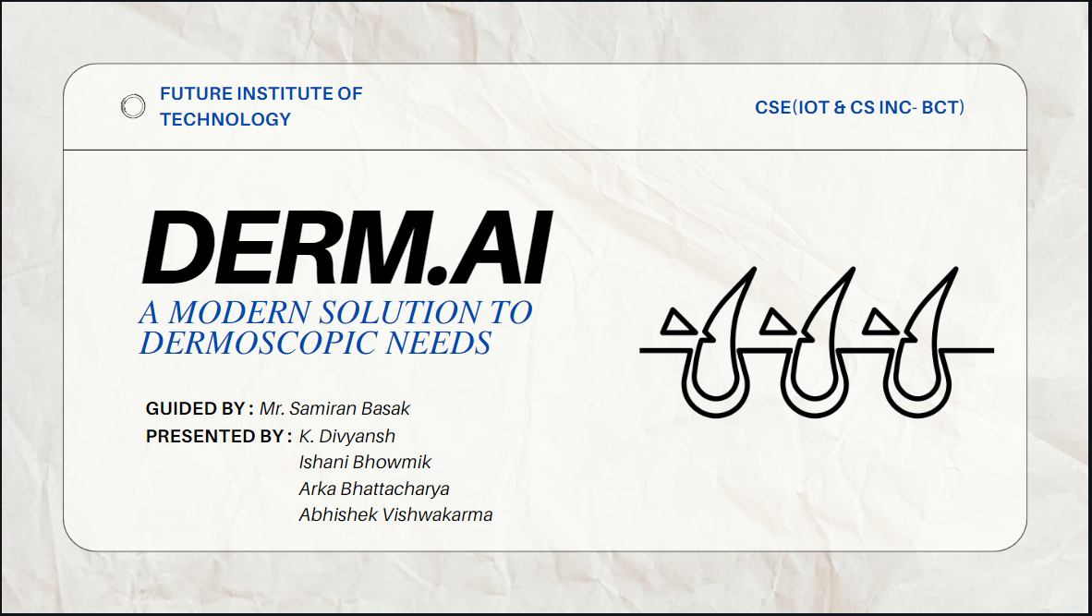

Slide 2
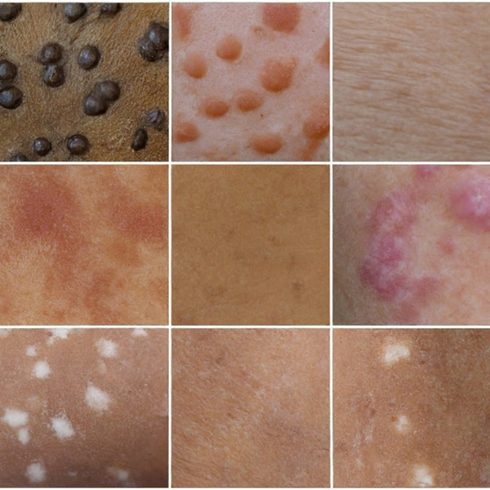
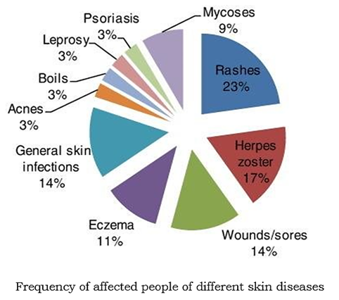
Skin Pigmentation Disorder: A Major Concern in India
Close-up of a person's skin with (i) melanocytic nevus (ii) seborrheic dermatitis (iii) acne (iv) eczema (v) pityriasis rosea (vi) psoriasis (vii) albinism

Slide 3
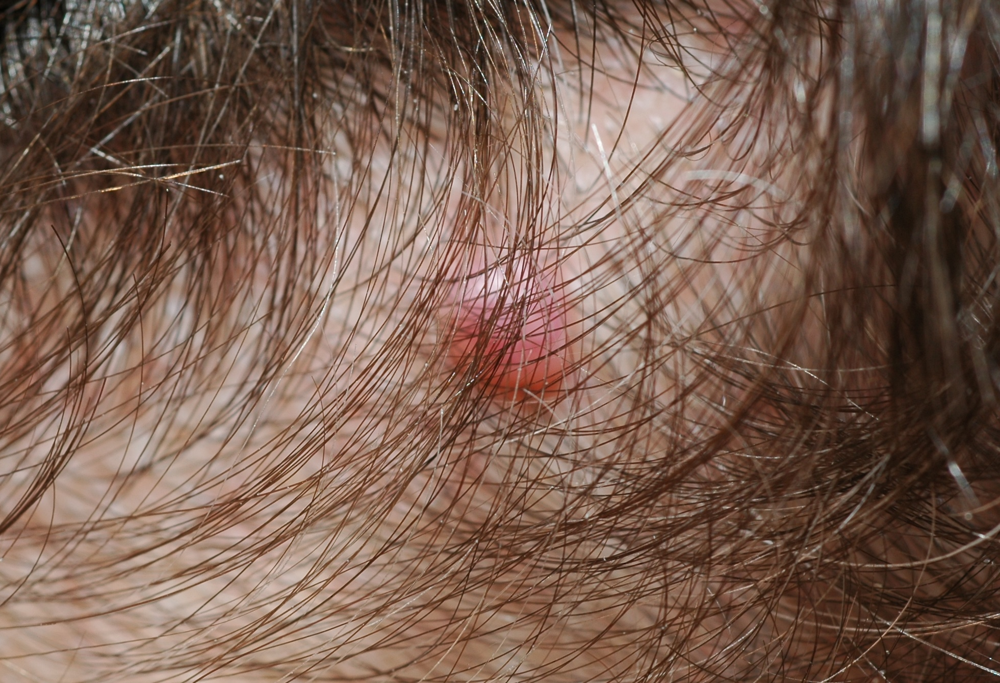
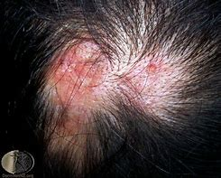
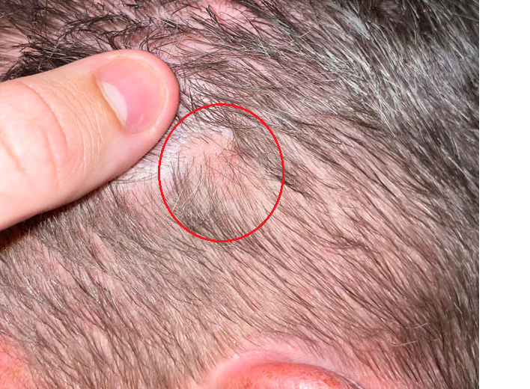
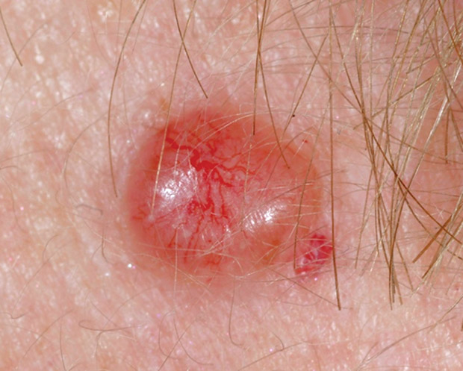
Body Hair: A Hurdle in Skin Disease Treatment
Notes:
Melanoma, lupus scalp, red skin cancer,

Slide 4
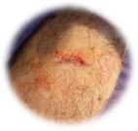
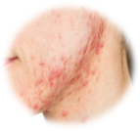
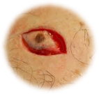
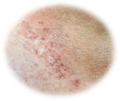
Traditional Body Hair Removal Strategies for Optimal Treatment
Trimming
Shaving
Depilatory Creams
Laser hair removal

Slide 5
Comparative Study of Existing Hair Segmentation Techniques
DullRazor
Huang et al
Xie et al.
E-shaver
(Lee et al., 1997)
(2009)
Fiorese et al.
(2011)
(2013)
(Li et al., 2014)

Slide 6
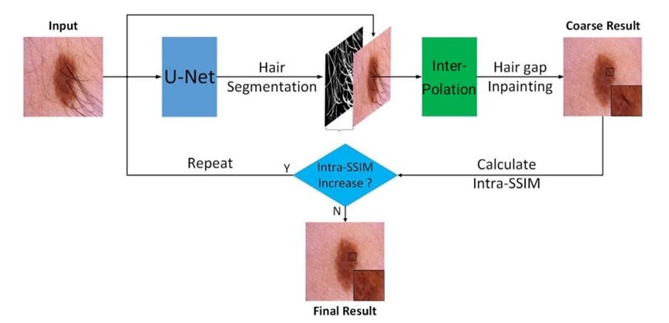
DermNet.AI: Our Approach for Hair Removal using AI

Slide 7
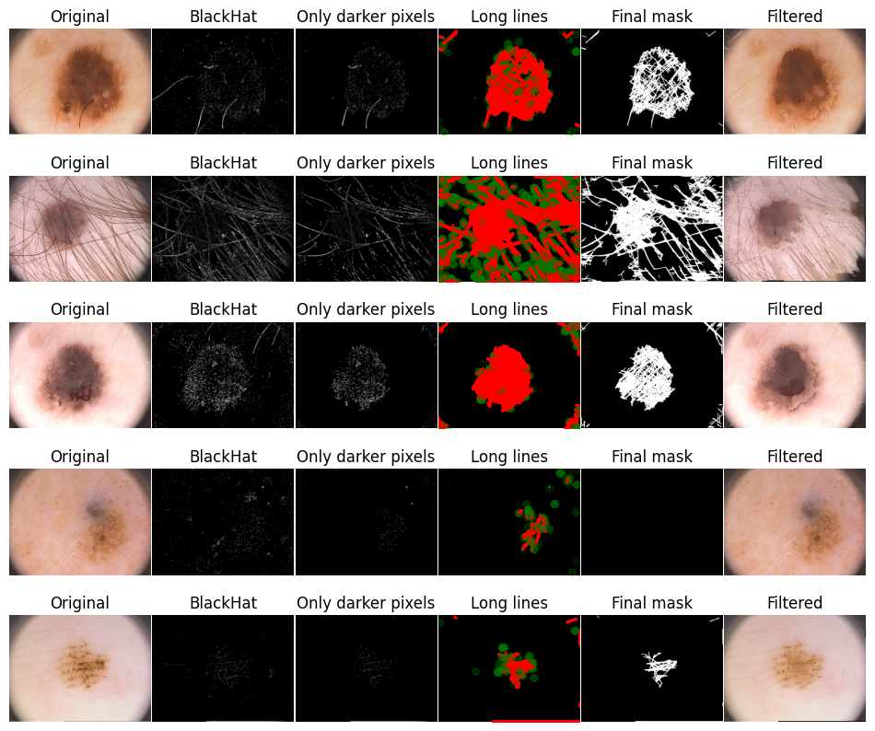
DermNet.AI: Our Approach for Hair Removal using AI

Slide 8
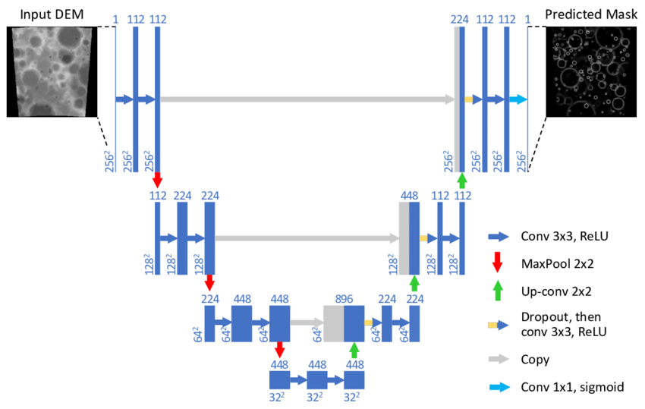
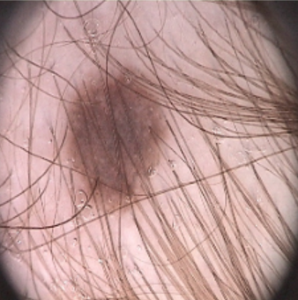
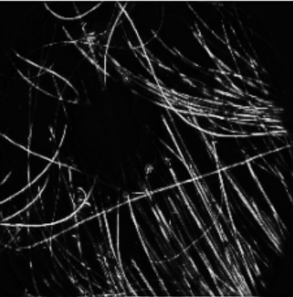
Architecture of Model Implemented For Mask Generation

Slide 9
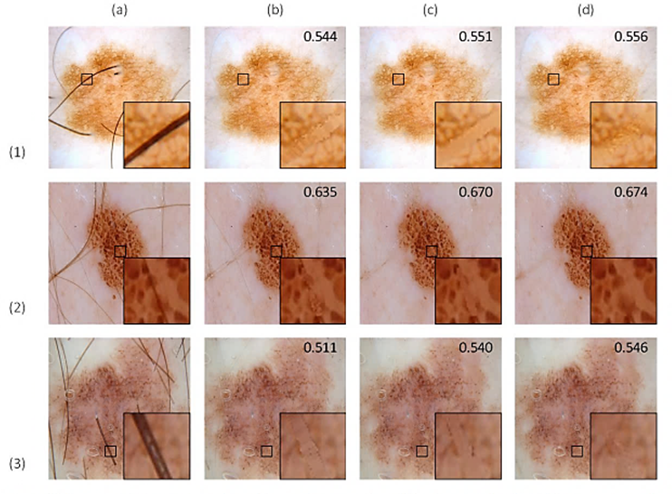
Quantitative Comparison Of Hair
Gap Inpainting
Qualitative comparison of hair gap inpainting results:
(a) Input images
(b) Dull Razor
(c) Huang et al
(d) Proposed Model
The inset in each image shows the zoomed in enlargement of the hair gap inpainting results for clearer visualization. The value of the SSIM of each image is also denoted.

Slide 10
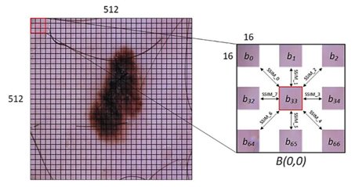
Dataset for Model Training
Hair segmentation
Training: 140
Validation: 20
Testing: 40
Image size: 512x512
Dataset used:
Modified PH-2 (ModPH-2)

Slide 11
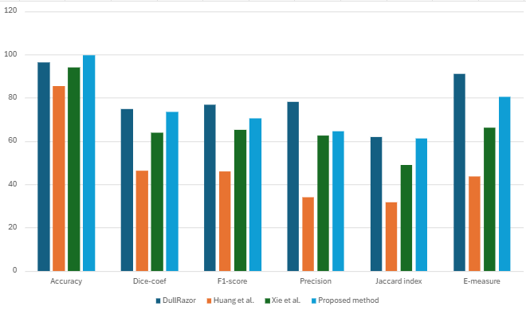
Quantitative Comparison Of Hair Segmentation
Dull Razor
Accuracy: 96.38
Dice-coef: 74.70
Proposed method
F1 score: 76.88
Precision:78.13
Jaccard Index:61.88
E-measure:90.94
Accuracy: 99.78
Dice-coef: 73.43
F1 score: 70.49
Precision:64.64
Jaccard Index:61.18
E-measure:80.52
Huang et al.
Accuracy: 85.58
Dice-coef: 46.21
F1 score: 46.09
Precision:33.89
Jaccard Index:31.64
E-measure:43.80
Xie et al.
Accuracy: 93.92
Dice-coef: 63.72
F1 score: 65.32
Precision:62.41
Jaccard Index:49.09
E-measure:66.17

Slide 12
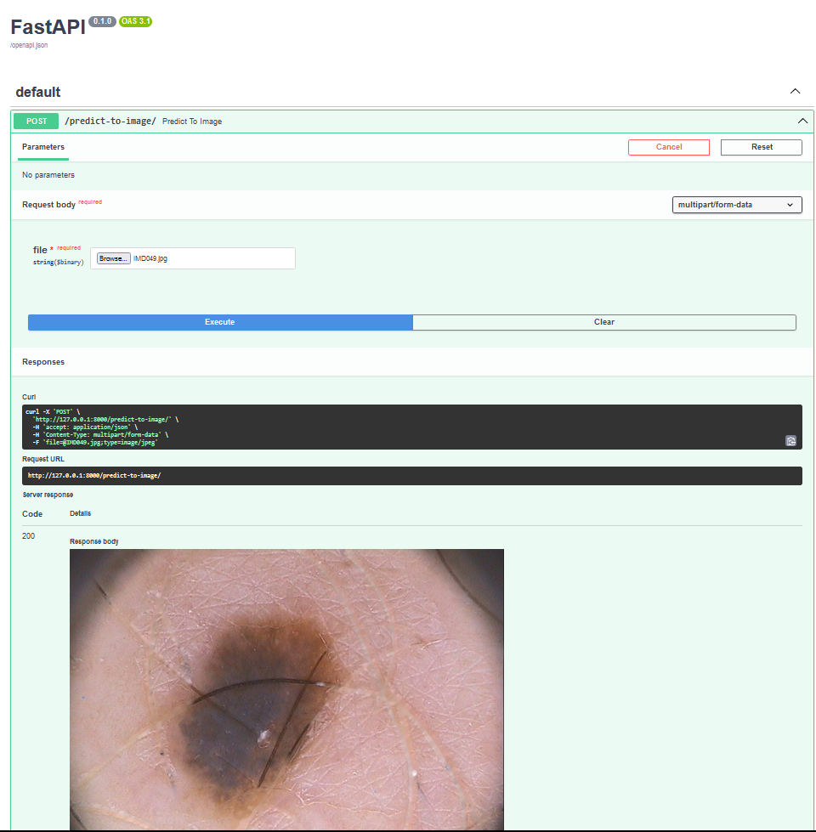
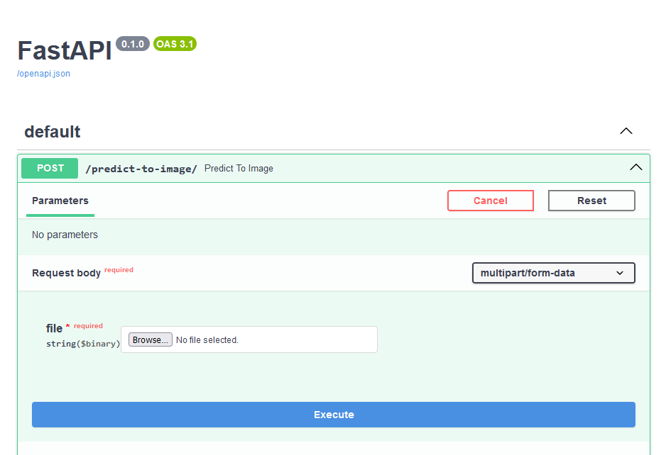
API Deployment

Slide 13
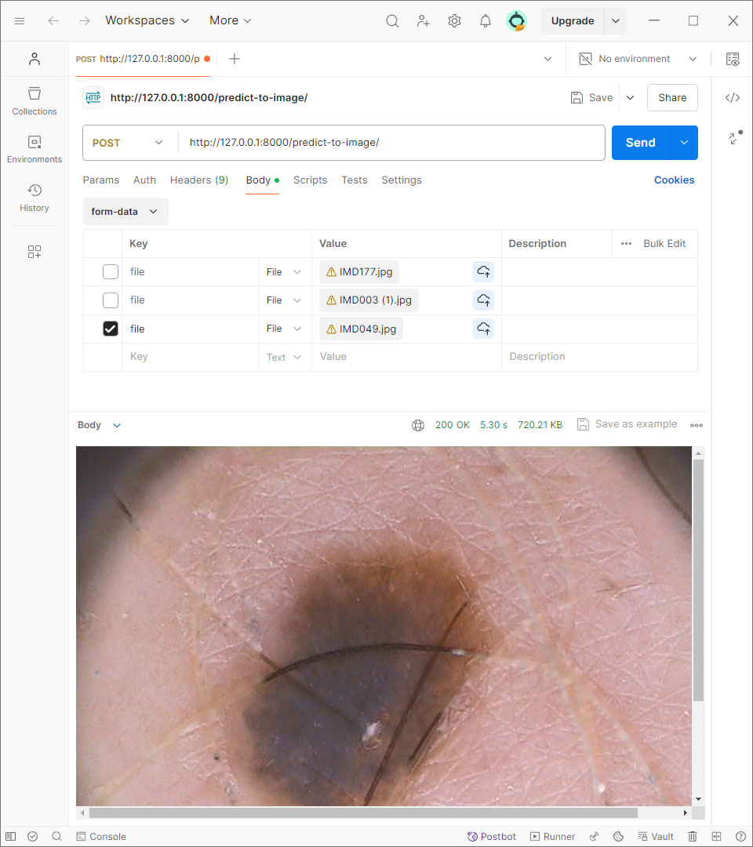
API Deployment: Postman Tool Testing

Slide 14
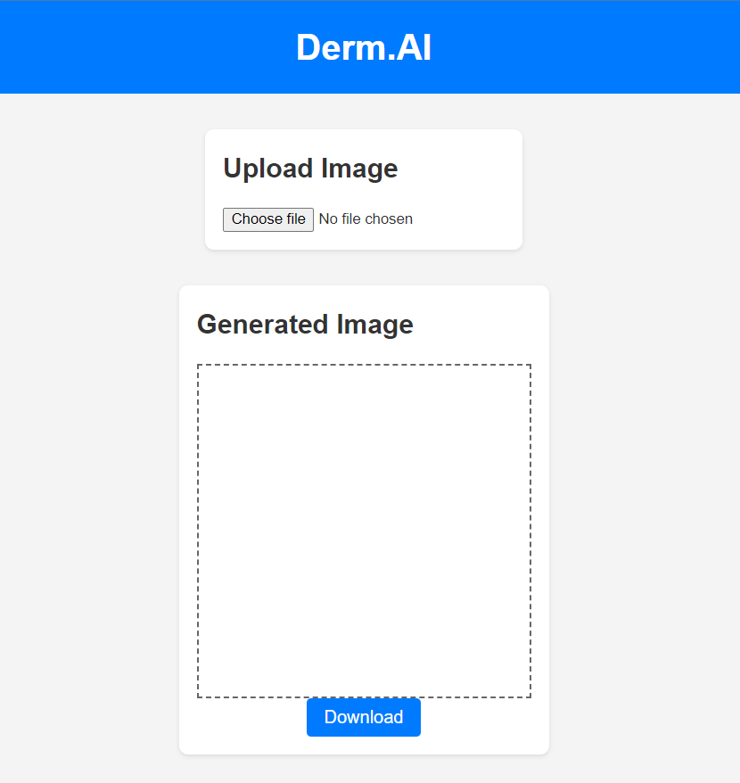
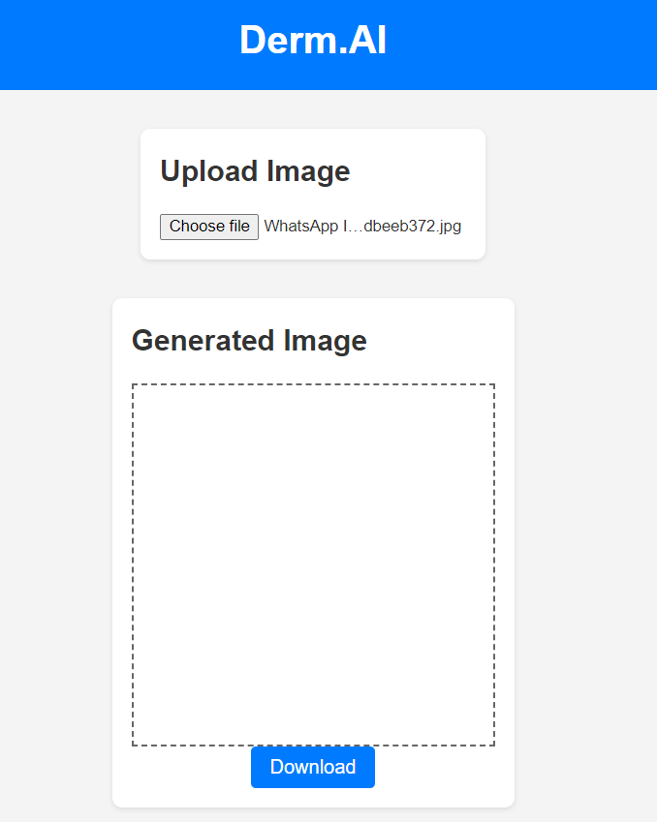
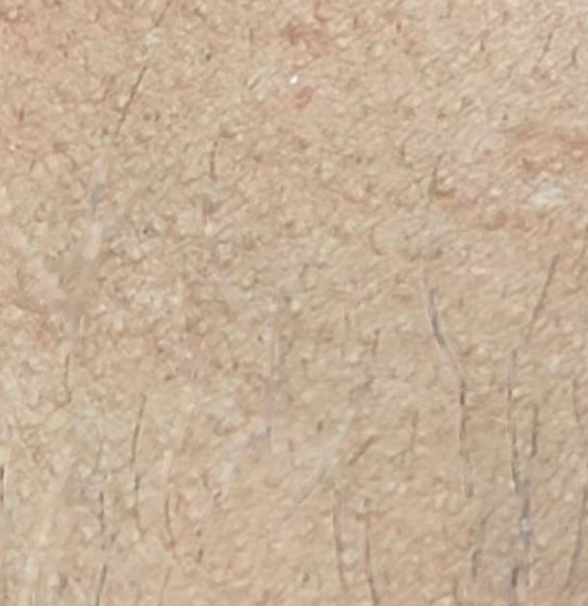
Frontend Deployment Demonstration

Slide 15
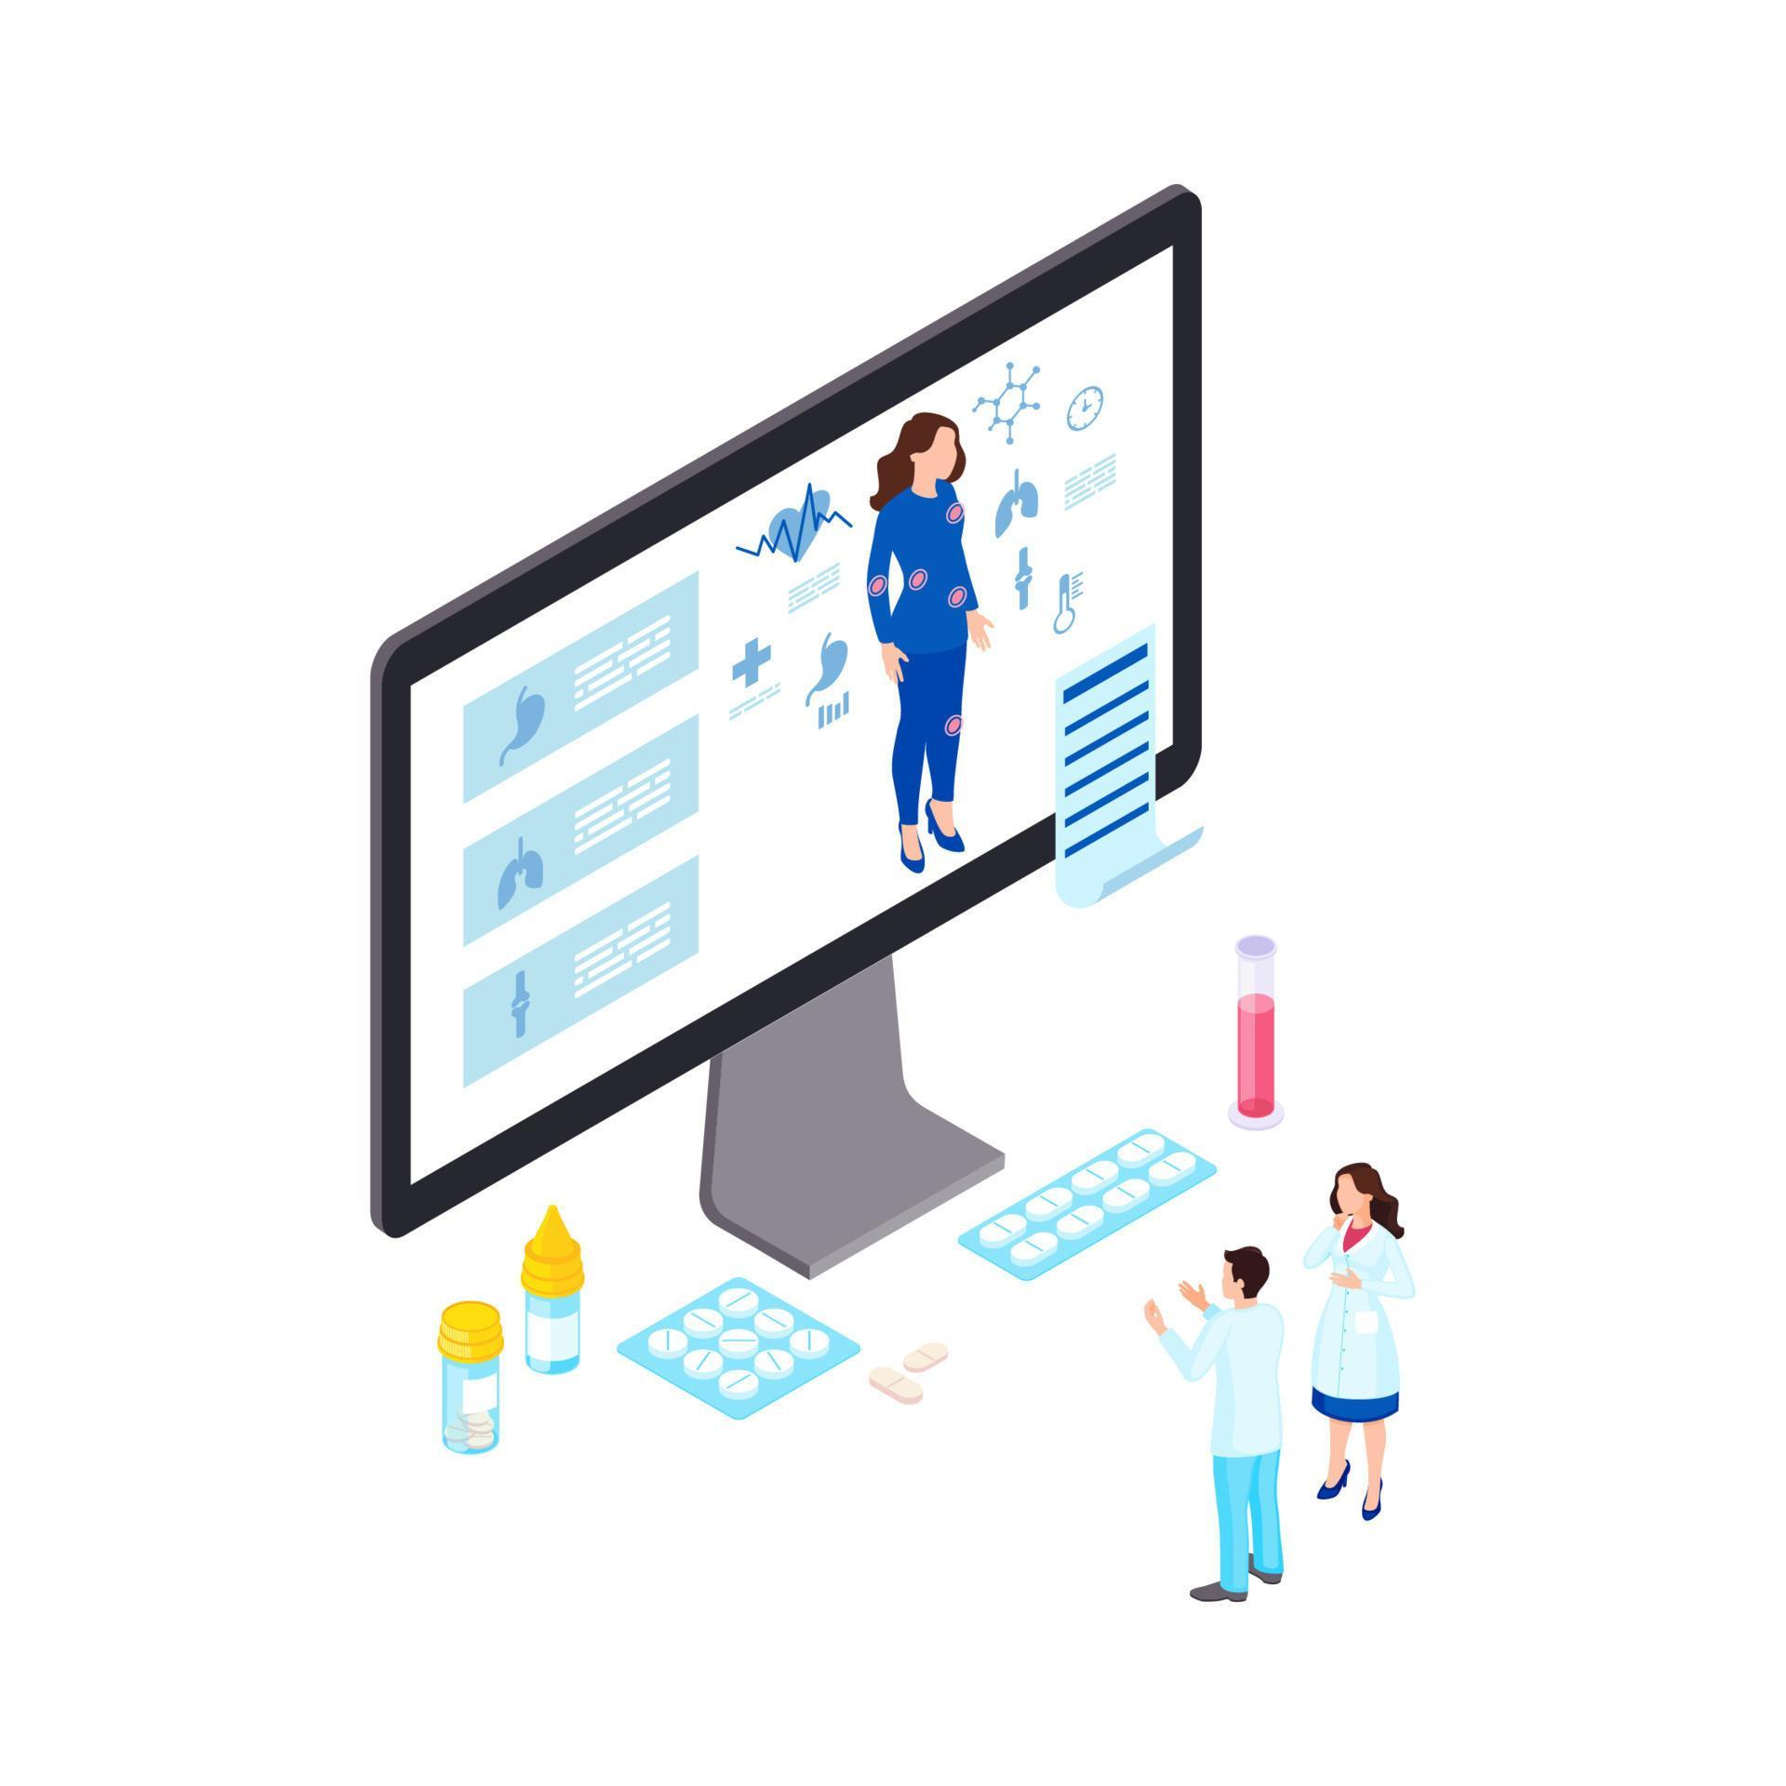
Conclusion
Enhanced Accuracy and Automation
Deep Learning Advancements
Automated Analysis
Integration with Telemedicine
Remote Diagnosis
Real-Time Feedback
Personalization and Early Detection
Skin Type and Hair Color Recognition
AI-powered Risk Assessments
Beyond Dermatology
Object Removal for Other Medical Fields
Forensic Applications

Slide 16
THANK YOU

